Slide 1


Informative Dropout for Robust Representation Learning: A Shape-bias Perspective
Baifeng Shi*, Dinghuai Zhang*, Qi Dai, Zhanxing Zhu, Yadong Mu, Jingdong Wang
Notes:
Hello, thank you for listening! I’m Baifeng Shi, from Peking University. I’m here to present our recent work “Informative Dropout for Robust Representation Learning: A Shape-bias Perspective”.

Slide 2
Contents
Backgrounds
A brief overview
Informative Dropout
Methodology
Experiments
Conclusion & Take home messages
Notes:
In this talk, I will first introduce the background of this work and our motivation, which is followed by a brief overview of the work. Then I will dive into details of our main contributions, both methodologically and experimentally. In the end, I will conclude the whole presentation.

Slide 3
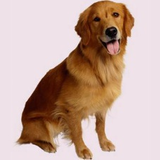
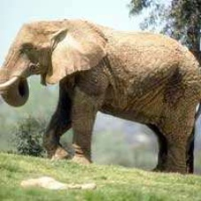


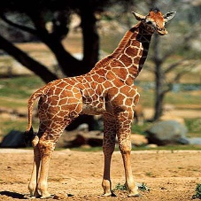
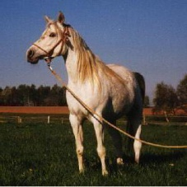
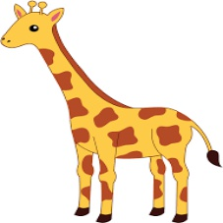
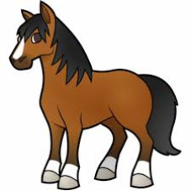
CNN is not robust
😀
😵
Notes:
So first, let’s take a look at the background. One of the main problems of current convolutional neural network, or CNN, is that, it is not robust in different kinds of situations.
For example, when there is a distribution shift between training images and test images, a CNN may not generalize really well.

Slide 4
CNN is not robust
vs.
vs.
😀
😵
Notes:
Or, if CNN is trained to recognize some types of objects or animals, the feature it has learned may not work really well on other types of animals.

Slide 5
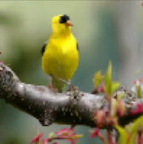
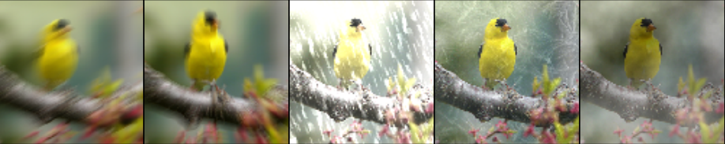
CNN is not robust
😀
😵
Notes:
Also, CNN’s performance can drop really fast when there is a random noise or corruption in the input images, which is very common in realistic usage.

Slide 6
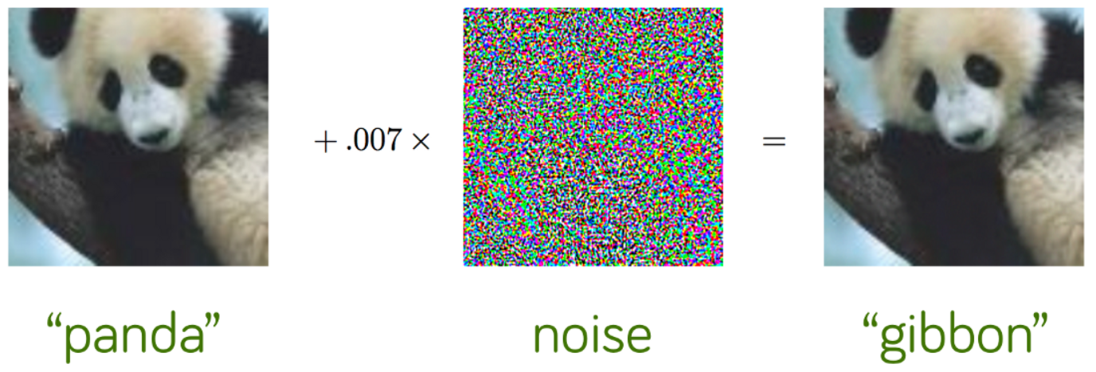
CNN is not robust
😀
😵
Notes:
It is also well-known that, a small, imperceptible manually-designed noise, which is called adversarial perturbation, can completely break a CNN.
These are all examples that CNNs are non-robust against distribution shift, random corruption, adversarial perturbation, especially when compared to human eyes.

Slide 7
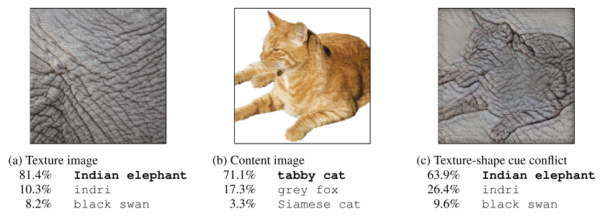
CNN is biased towards texture
ImageNet-trained CNNs are biased towards texture; increasing shape bias improves accuracy and robustness, R Geirhos et al., ICLR’19
Notes:
Another intriguing property of CNN, which is found recently, is that CNN tends to make decisions based on texture information in an image, instead of the shape and global structure information. This is in contrast with our prior expectation that CNN first recognize visual primitives like edges and corners in its early layers, and then compose them into some complex shape. For example, if we combine local texture of an elephant and shape of a cat, a CNN will recognize it as an elephant, instead of a cat.

Slide 8
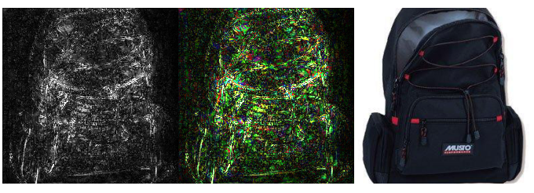
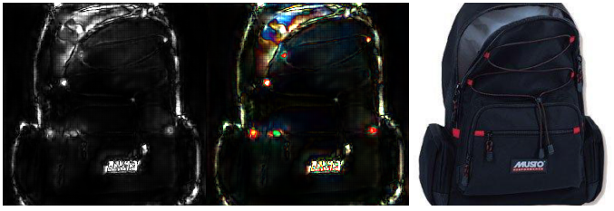
Robustness -> shape-bias
Regular CNN
Adversarially-trained CNN
Interpreting Adversarially Trained Convolutional Neural Networks, Tianyuan Zhang et al., ICML’19
Notes:
Actually, there seems to be a close connection between CNN’s non-robustness and its bias towards texture. As observed by a recent work, after CNN is adversarially trained, it naturally obtains a bias towards shape, and is insensitive to texture. This implies that robust models should have shape-bias instead of texture-bias.

Slide 9
Is texture-bias a common reason for CNN’s non-robustness?
Notes:
This brings out a question: Is texture-bias the common reason why CNNs are extremely vulnerable under situations with distribution shift, random corruption, adversarial perturbation?

Slide 10
Overview
Our motivation: Improve robustness by training a shape-biased model
Methodology:
Design an algorithm to automatically detect shape/texture
Train a model to be insensitive to texture
Experiments:
Is our model more shape-biased?
Is our model more robust?
domain generalization, few-shot learning, random corruption, adversarial perturbation
Notes:
This motivates our work. We want to see if texture-bias is the common reason of CNN’s different kinds of non-robustness. Specifically, we wonder if we can improve CNN’s robustness by training a more shape-biased model.
To train a shape-biased model, we first need to design an algorithm to decide what’s texture and what’s shape. Then we have to train a model so that it is less sensitive to all the texture, and depend more on the shape information.
Then for experiments, we first see that if our model is truly shape-biased, and then test our model’s robustness under different settings including ….., to see if there’s any improvement.

Slide 11
Methodology
Notes:
Now we start with the method.

Slide 12
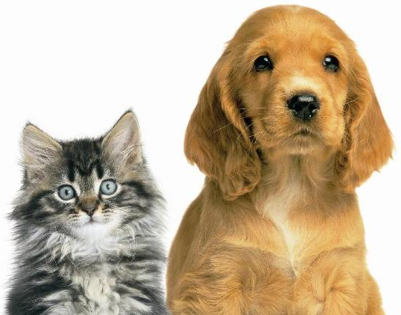
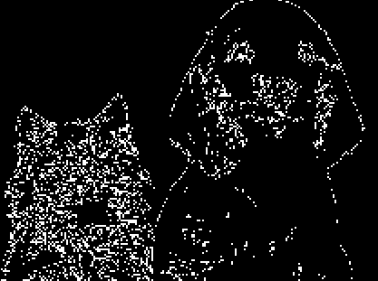
How to detect shape/texture?
Edge detection?
– not robust to complex texture
Edge detector
Poor little cat…
Notes:
So the first question is, how can we detect shape and texture.
The first idea would be edge detection. Since the shape is basically edges, so we can directly detect edges with some edge detection method, and use it as the input. However, as shown in the figure, edge detection may fail from time to time, even ruining the content of the image, especially when there is some complex texture.

Slide 13
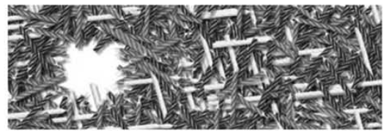
Eye fixation and saliency detection
Humans tend to look at regions with high self-information (“surprise”)
Saliency Based on Information Maximization, N Bruce et al., NIPS’06
Notes:
So in this work, we take another approach. We get the inspiration from earlier work on human eye fixation and saliency detection. This work found that when looking at an image, humans tend to first look at the regions with high self-information. Later we will explain that self-information means. Intuitively, one can understand it as a level of difference between the current region and the surrounding regions. When a region is different from other regions, it contains more surprise. For example, when you look at this image, you may focus on the blank area, because this area is different from the surrounding area, which is colored and messy.

Slide 14
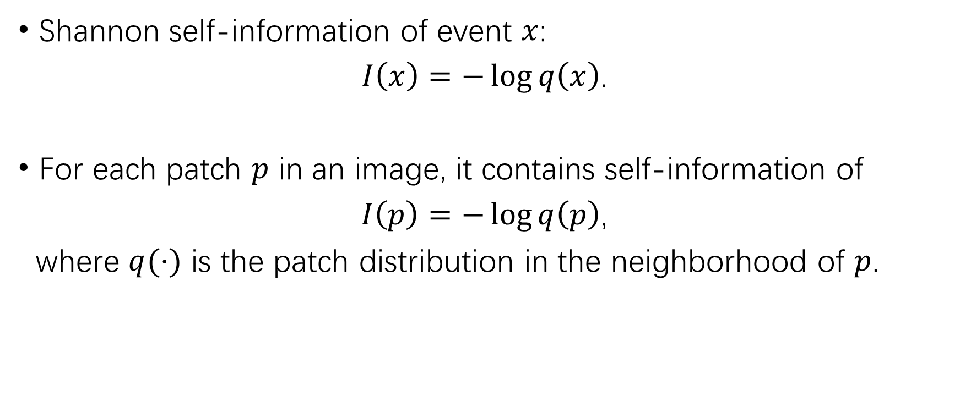
Information-based detector
Shannon self-information of event $x$:
$I\left(x\right)=−\log{q\left(x\right)}$.
For each patch $p$ in an image, it contains self-information of
$I\left(p\right)=−\log{q\left(p\right)}$,
where $q(⋅)$ is the patch distribution in the neighborhood of $p$.
Notes:
Formally, we can describe it with the Shannon self-information, which is defined as the negative logarithm of the probability of an event x. In our case, we care about the information contained in some location in the image. We formulate this as the self-information of the patch at this location. If we assume that this patch p, along with the patches in the neighborhood, are all sampled from some distribution q. Then we can estimate the information of p as the negative logarithm of q of p.

Slide 15
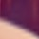



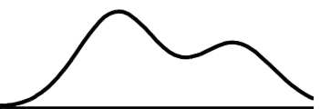
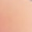
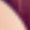


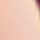
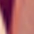



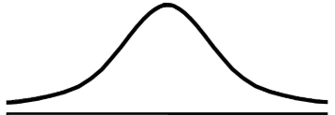


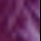


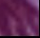
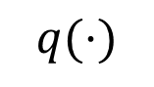
Information-based detector
low prob
high information
high prob
low information
$$q(⋅)$$
Notes:
Let’s look at an example. In this image, we select two patches, one on her shoulder, and another on this purple ornament on this hat. We also crop out the eight patches around each patch. For the first patch on her shoulder, since we assume that this patch and the patches around are sampled from the same distribution, we can somehow reconstruct the distribution from these nine samples. And since the center patch is different from other patches, it may lie in some local minima of the distribution, which means it has a low probability, and thus high self-information. For the second patch, we can see that this patch and the surrounding patches all look really similar, which means they all have a high probability, and thus low information.

Slide 16
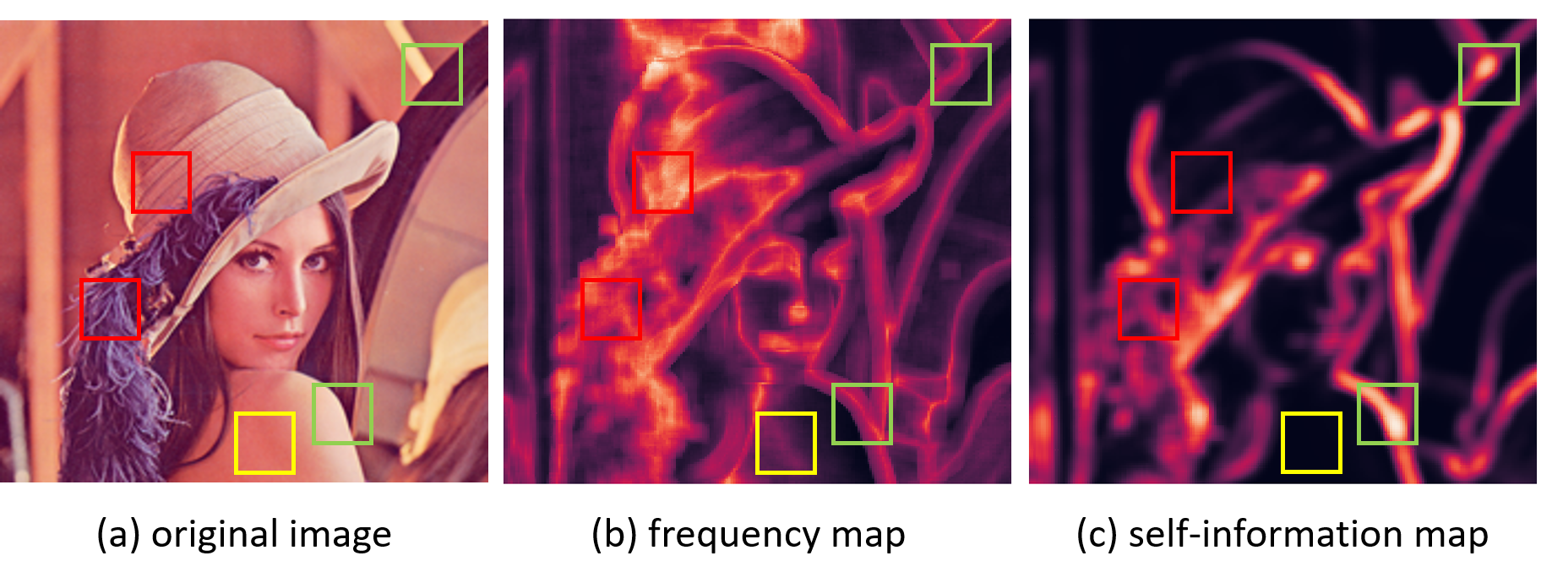
An intuitive explanation
texture
shape
flat region
Notes:
So what’s the relationship between self-information and detection of shape and texture? Here’s an intuitive explanation from frequency. Since texture has higher frequency, the same pattern may repeat itself in a small region, thus have low information. However, for shape, like edges or corners, they are more unique in its neighborhood, and look more different from the surrounding patches, thus having a higher information. This figure illustrates the relationship between frequency and self-information.
So this means, we can simply calculate the self-information of each patch, and if it has low information, then it’s more likely to be texture, otherwise it is shape.

Slide 17
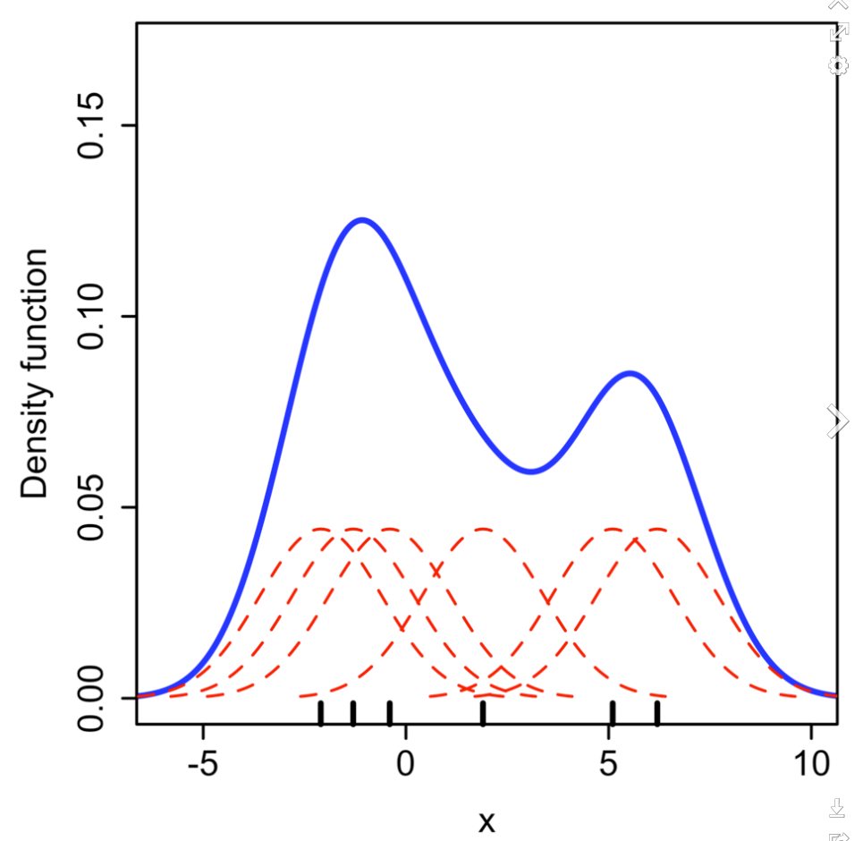
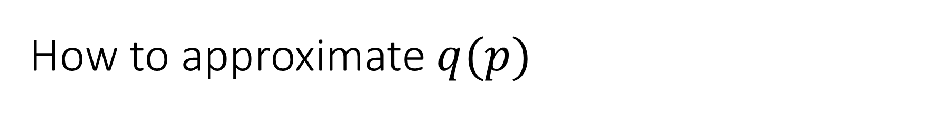
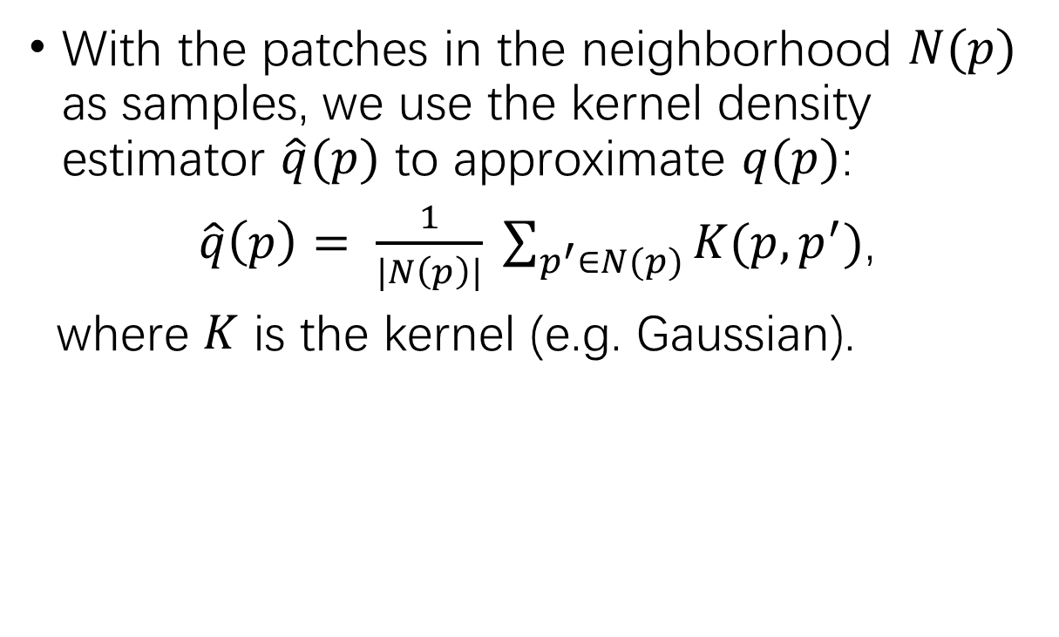
How to approximate $q(p)$
With the patches in the neighborhood $N(p)$ as samples, we use the kernel density estimator $\hat{q}(p)$ to approximate $q(p)$:
$\hat{q}\left(p\right)= \frac{1}{|N\left(p\right)|} \sum_{p^{′}∈N(p)}{K(p, p^{′})}$,
where $K$ is the kernel (e.g. Gaussian).
Notes:
Now we can detect shape or texture by its self-information. The remaining question is how to estimate the information. Specifically, how to estimate the distribution q. Here we simply take a kernel density estimator, with the patches in the neighborhood as samples.

Slide 18
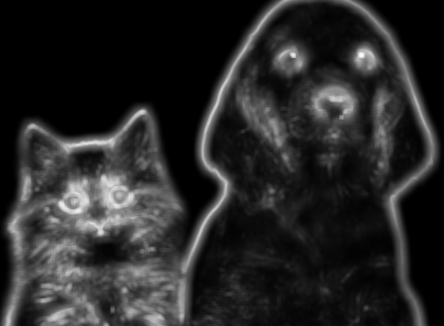
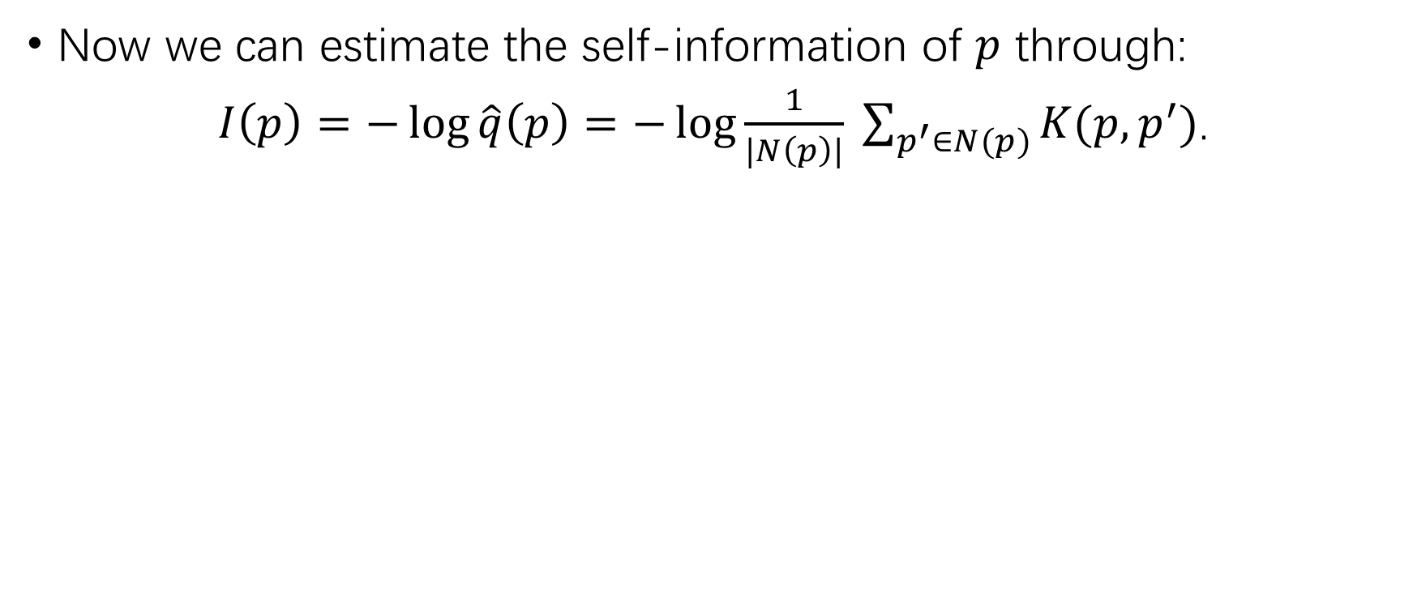
Information-based detector
Now we can estimate the self-information of $p$ through:
$I\left(p\right)=−\log{\hat{q}\left(p\right)}=−\log{\frac{1}{|N\left(p\right)|} \sum_{p^{′}∈N(p)}{K(p, p^{′})}}$.
(a) Original image
(b) Edge detection
(c) Information-guided
Notes:
In this way, we can efficiently estimate the self-information. Here is an illustration of the information in the image. We see that the edges, and important features like eyes and noses all contain high information, while textures like the hair contains less information.

Slide 19
From images to feature maps
We can also estimate the self-information of patches in a feature map.
We find it the best practice to use our method on input image AND feature maps in CNN’s early layers.
Notes:
Note that this can also work on the feature maps in intermediate layers. We can see them as images with multiple channels. In practice we find that we can get the best performance when applying our method on input image as well as feature maps in early layers.

Slide 20

Towards a shape-biased model
Objective: make the model insensitive to low-information regions (texture)
Our approach: a dropout-like algorithm
Lower information -> higher drop rate
Notes:
Since we already can detect texture and shape, we only have to train the model so that it is insensitive to the texture. Here we adopt a dropout-like algorithm. But instead of drop each neuron with the same probability, we prefer to drop the neurons with less information. In each layer, each patch in the input corresponds to a neuron in the output. If the patch contains less information, we will drop the corresponding output neuron with a higher probability. In this way, the texture is dropped more frequently, and the network will be independent on the texture.

Slide 21
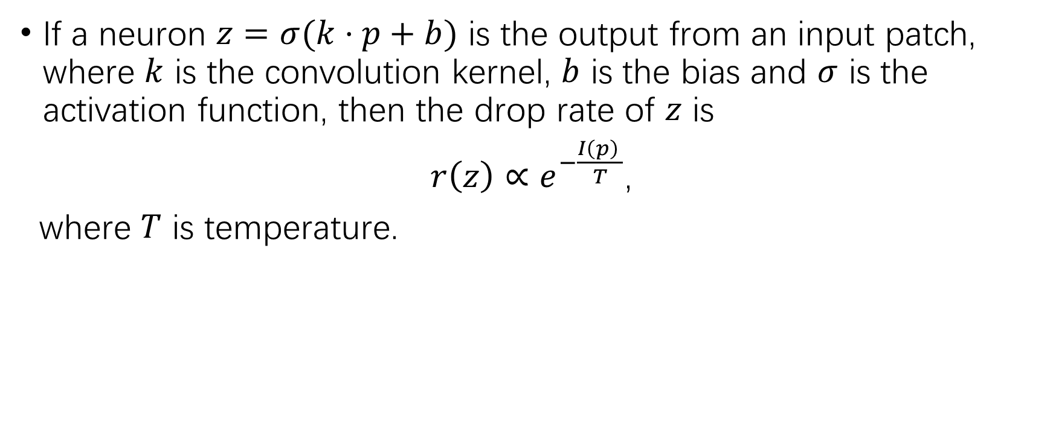
Informative Dropout (InfoDrop)
If a neuron $z=σ(k⋅p+b)$ is the output from an input patch, where $k$ is the convolution kernel, $b$ is the bias and $σ$ is the activation function, then the drop rate of $z$ is
$r\left(z\right)∝e^{−\frac{I\left(p\right) }{T}}$,
where $T$ is temperature.
Notes:
Specifically, the drop rate of each neuron is defined as this. Here T is the temperature. When T goes to infinity, the drop rate will be the same for all neurons, and if T goes to 0, then only the patches with the least information are dropped. Normally, we set T as some positive value. We name this algorithm as Informative Dropout, or InfoDrop for short.

Slide 22
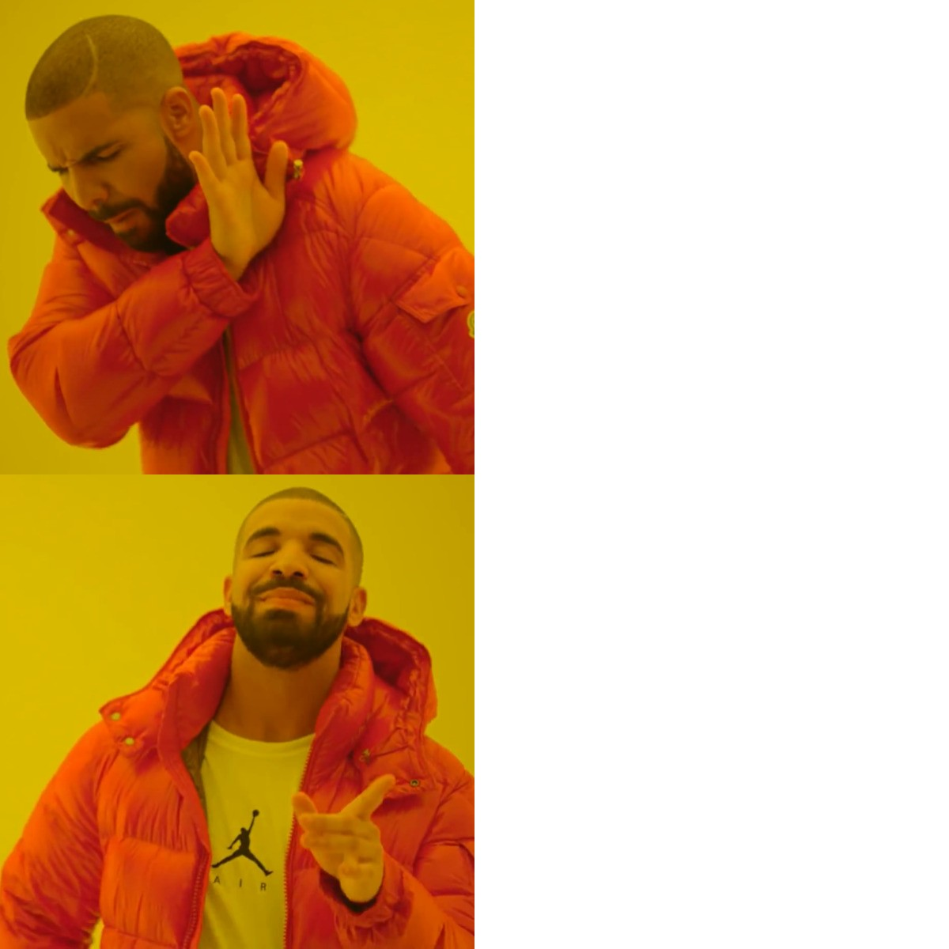
“Internal” shape-bias
During inference:
Use InfoDrop to “intentionally” remove texture
The convolution kernels can automatically filter out texture
Notes:
Now we can use InfoDrop to train a shape-biased model. One last problem is that, by using InfoDrop, we seem to “intentionally” remove the texture, so that our network can depend on shape. However, it’s better to train a network that can filter out the texture by itself, which means it has an “internal” shape-bias.

Slide 23
“Internal” shape-bias
We want to throw away InfoDrop during inference
Directly removing it may cause troubles
e.g. statistical mismatch in BatchNorm
We first train with InfoDrop on, and then remove InfoDrop and finetune on the training data.
Notes:
To see if this is the case, we propose to first train a network with InfoDrop on, and then throw out the InfoDrop and finetune on the training data. And during inference, we just use the network without InfoDrop, and test its shape-bias and robustness.

Slide 24
Experiments
Notes:
Now we move on to experiments.

Slide 25
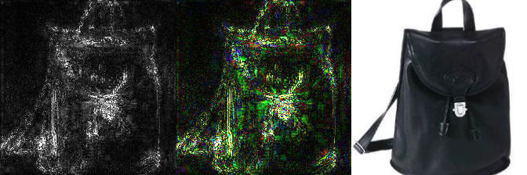
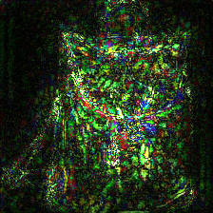
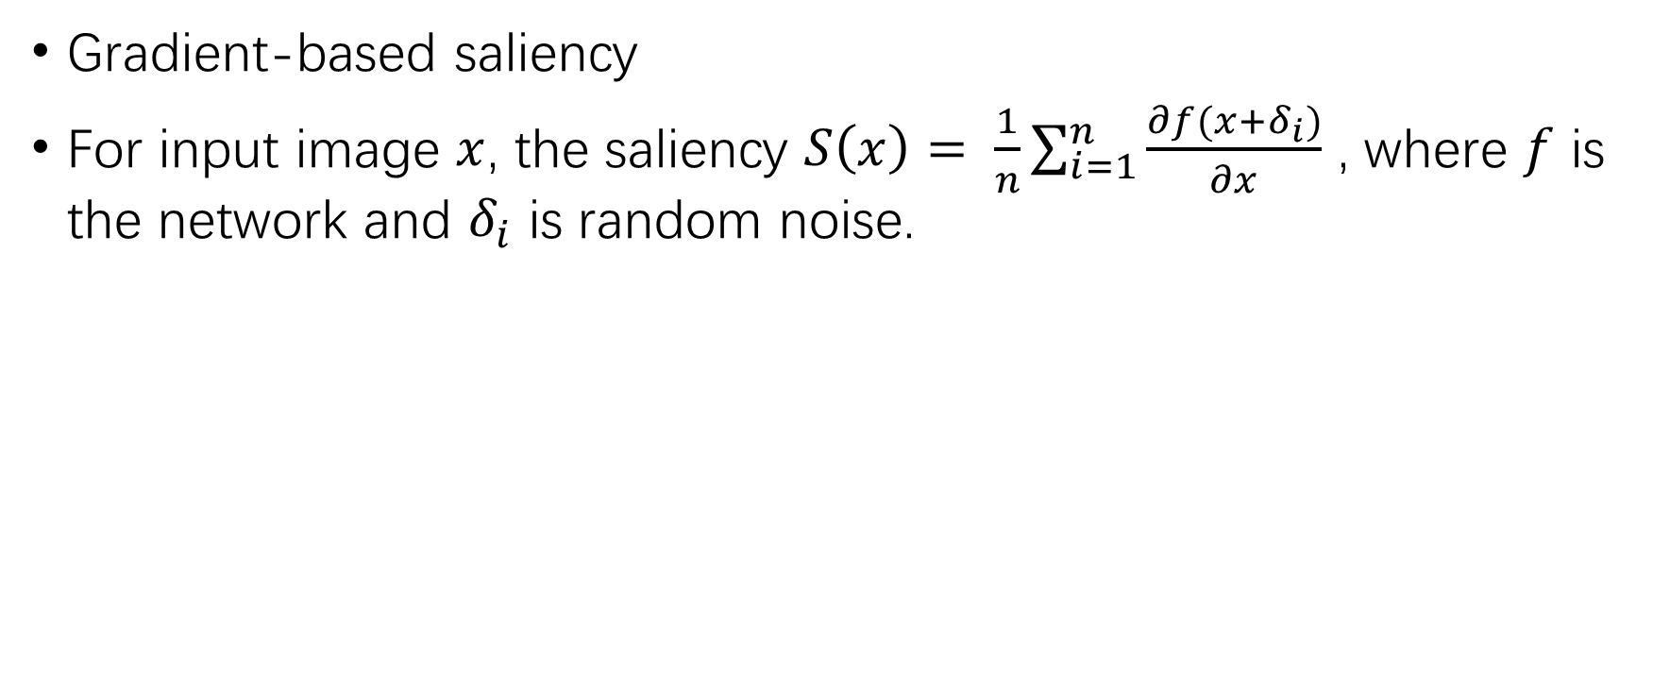
Is our model more shape-biased now?
Gradient-based saliency
For input image $x$, the saliency $S\left(x\right)= \frac{1}{n}\sum_{i=1}^{n}{\frac{∂f(x+δ_{i})}{∂x}}$ , where $f$ is the network and $δ_{i}$ is random noise.
regular CNN
w/ InfoDrop
input image
Notes:
First we test our model’s shape-bias. We first show the saliency map, which is the gradient norm w.r.t. each pixel. Larger gradient indicates salient regions. We can see that with InfoDrop, the model is less sensitive to texture, and depend more on shape.

Slide 26


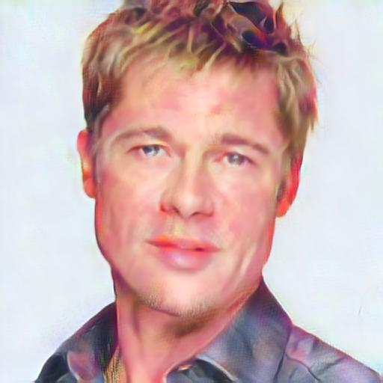

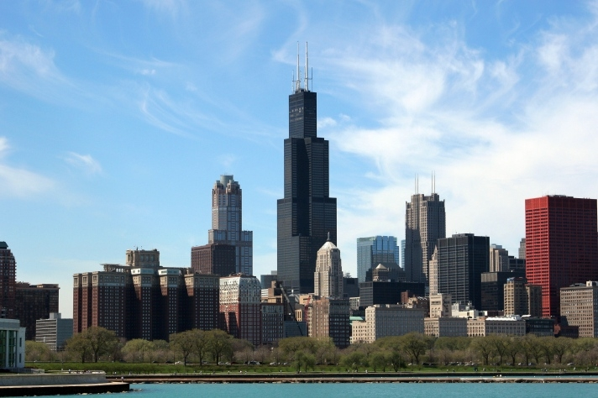
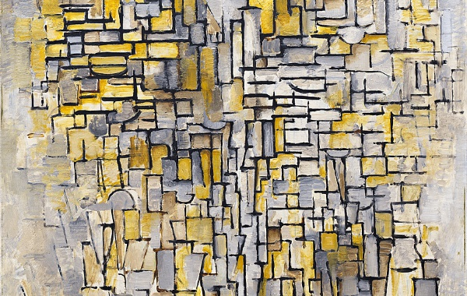
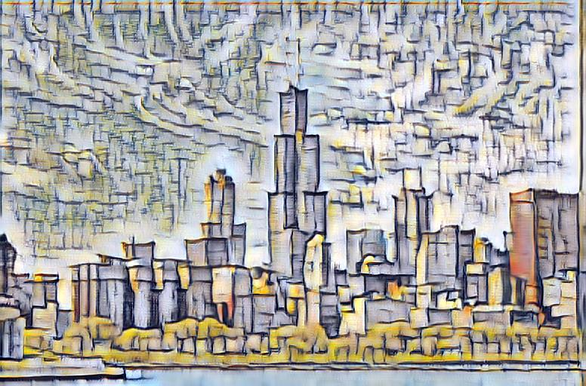
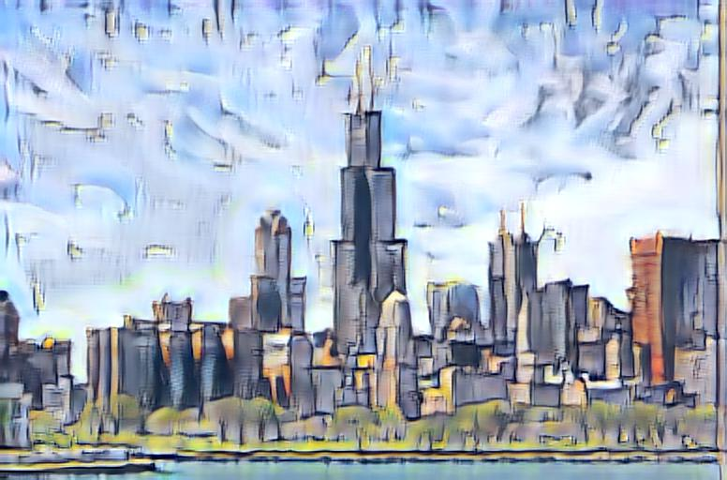
Is our model more shape-biased now?
Style Transfer
Add InfoDrop to extract and transfer only shape feature
Notes:
We also illustrate the shape-bias with a style-transfer experiment. In regular style-transfer, the style of content image (the first column) is replaced by that of style image (second column). And the result is shown in the third column. However, if we add InfoDrop in the encoder, now only this edging, sketching style is transferred, and the texture is preserved, as shown in the last column.
Both of the experiments confirms that, our model is now more biased towards shape.

Slide 27
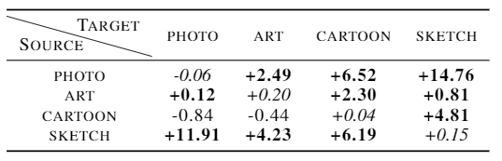
Is our model more robust now?
Domain generalization
distribution shift between training/test images
PACS dataset: 4 domains (photo, art, cartoon, sketch)
After applying InfoDrop:
Notes:
Now we test our model’s robustness. First we test domain genenralization, where a distribution shift exists between training and testing images. Our goal is to train the model on the source domain, and test its performance on target domain. Here we use the PACS dataset. We can see that after applying InfoDrop, the performance is improved by a large margin, which means our model is more robust to data distribution shift.

Slide 28
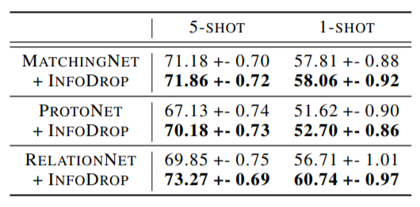
Is our model more robust now?
Few-shot Classification
class-wise distribution shift
CUB dataset
finegrained classification
Various baselines
ProtoNet, MatchingNet, RelationNet
Notes:
Then we test under the setting of few-shot classification. In this setting, there is distribution shift between the classes of training data and test data. The goal is to see if the feature learned on training classes can generalize to test classes. Here we show the results on CUB dataset. We use different baseline methods, including ProtoNet, MatchingNet and RelationNet. We can see that on different baselines, our method can bring a consistent improvement.

Slide 29
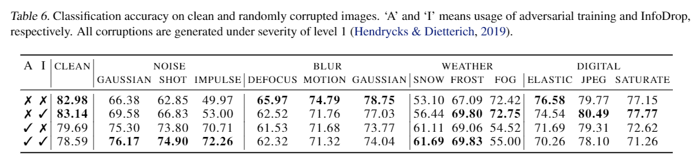
Is our model more robust now?
Random image corruption
Caltech-256 dataset
Corruption function from Imagenet-C
Notes:
We also test the robustness against image corruptions. Here we use Caltech dataset, and make corrupted images with the functions from Imagenet-C dataset. We test the robustness under level-1 corruption of different kinds, including noise, blur, weather and digital. As we can see, with InfoDrop, our model is more robust on most corruptions. Also, InfoDrop can be combined with adversarial training and get a further improvement.

Slide 30
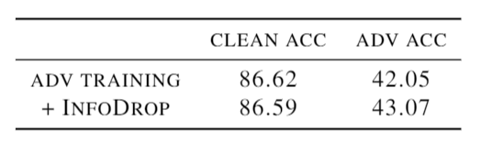
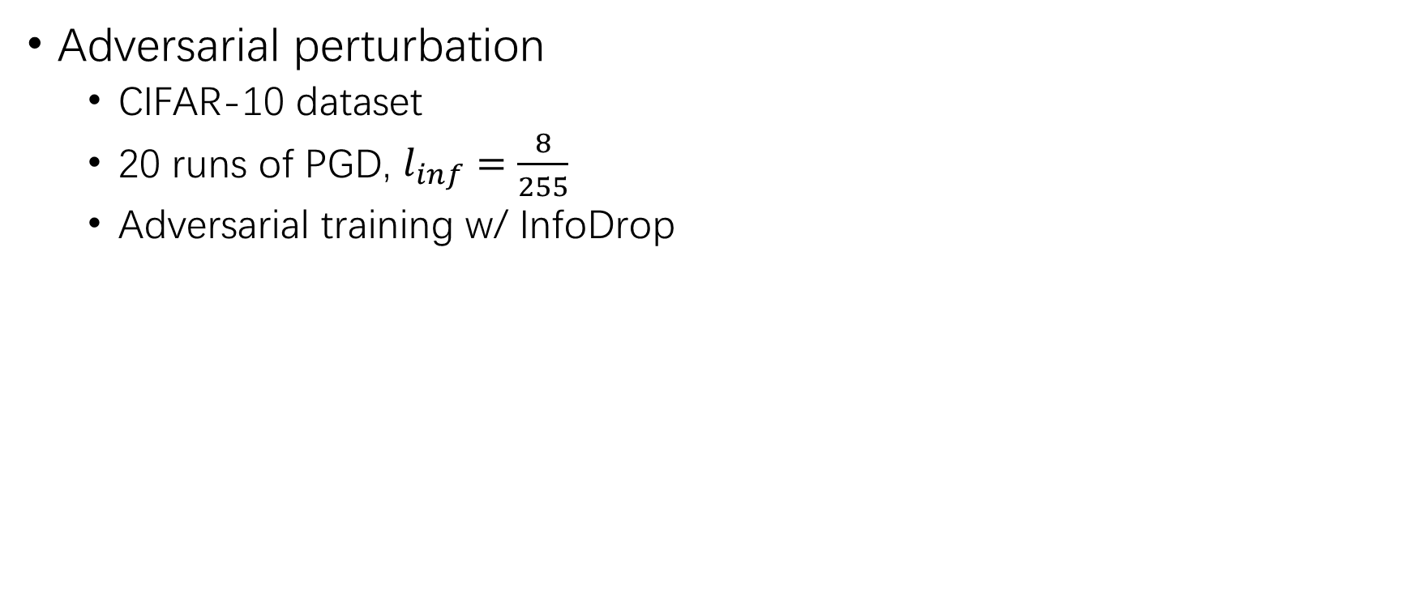
Is our model more robust now?
Adversarial perturbation
CIFAR-10 dataset
20 runs of PGD, $l_{inf}=\frac{8}{255}$
Adversarial training w/ InfoDrop
Notes:
Finally we test the robustness against adversarial perturbation. We use CIFAR-10 as dataset, with 20 runs of PGD. With InfoDrop, there is a slight improvement of 1 percent in adversarial accuracy.

Slide 31
Take home messages
Enhancing shape-bias can improve various kinds of robustness.
We can discriminate shape from texture based on self-information.
We can alleviate texture-bias through InfoDrop, an information-based add-on during training only.
With InfoDrop applied, CNN is more robust against distribution shift (domain generalization, few-shot learning), image corruption and adversarial perturbation.
Notes:
So in this work, we find that enhancing shape-bias can improve various kinds of robustness. Specifically, we design a information-based detector to discriminate shape and texture. Then we adopt a dropout-like algorithm, called InfoDrop, to train a model so that it is more biased towards shape. In this way, we observe improvements in different kinds of robustness.

Slide 32


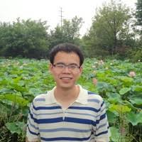
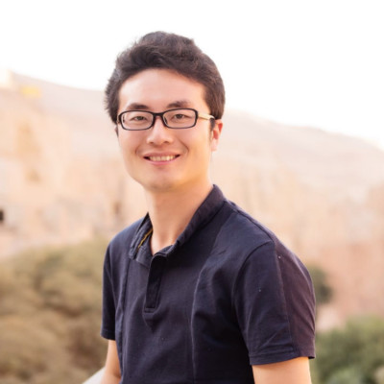
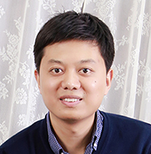

Many thanks to all the collaborators!
Code will be available on GitHub:
https://github.com/bfshi/InfoDrop
Contact: Baifeng Shi
https://bfshi.github.io/
bfshi@pku.edu.cn
Notes:
I wanna thank all my collaborators. Our code will be released on GitHub. Thank you for listening!

